Slide 1
Template Classes
chp2, p111-112

Slide 2
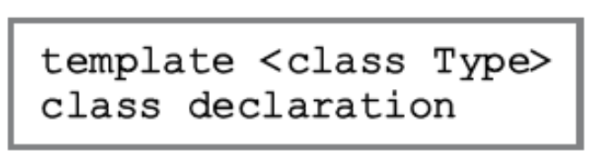
template classes
Write a single code segment for a set of related classes
Same template line before class definition as used in template functions
There is a slight change to making an object of a template class
class_name<data_type> object_name;

Slide 3
Example [chap03, page 170-186]
Converting into a template class
template <typename T>
class ArrayList
{
T *list;
int length;
int maxSize;
public:
void insert(T x);
void remove(T x)
};
class intArrayList
{
int *list;
int length;
int maxSize;
public:
void insert(int x);
void remove(int x)
};
int main(){
ArrayList <int> intList;
intList.insert(45);
intList.insert(13);
ArrayList <float> floatList;
floatList.insert(2.4);
floatList.insert(13.1);

